Slide 1


THE REPUBLIC OF SOUTH SUDAN
MINISTRY OF ENERGY AND DAMS
1st NATIONAL ECONOMIC CONFERENCE 4TH -8TH SEPTEMBER 2023
ENERGY SECTOR STATUS AND POTENTIAL RESOURCES
IN SOUTH SUDAN
Presented By: Eng. Tom Remis
Undersecretary
Ministry of Energy and Dams
Republic of Sudan Sudan

Slide 2
TABLE OF CONTENT
1. Energy Overview
2. Energy Policies and Strategies
3. Potential Energy Resources
4. Future Plan Projects
i. Short and Medium Terms
ii. Long Term
5. Transmission Lines Projects
i. Inter-States Power Transmission Lines
ii. Power Interconnection Transmission Lines
6. Challenges
7. Recommendations
8. Conclusions

Slide 3
ENERGY OVERVIEW
Although energy access rates are generally low in Sub Sahara Africa, the Republic of South Sudan (RSS) has the lowest rate (7%) and Per capita consumption of 3kwh.
The total installed capacity is 87MW.
There is no national grid (High Voltage Transmission Lines), only there are isolated distribution networks (Medium & Low Voltages) in some of the states.
The Growth of electricity sector in South Sudan is suppressed by supply not the demand.

Slide 4
ENERGY OVERVIEW (Cont.)
The demand for electricity is expected to increase by 7% to 8% annually based on the economic growth rate.
The power plants in South Sudan currently are burning diesel/heavy fuel oil(HFO); a very expensive and environmentally hazardous fuel for power generation.
The average generation cost is 0.373US$/kWh and the average tariff is 0.395US$/kWh.

Slide 5
ENERGY OVERVIEW (Cont.)
THE CURRENT INSTALLED CAPACITIES
No | Name Power Plant | Location | Capacity (MW) | Source of Energy | Status
1. | EZRA Diesel Power Plant | Juba | 33 | Diesel | Operational
2. | EZRA Solar PV | Juba | 20 | Solar | Expected to be commissioned in October 2023
3. | Nesitu Solar PV | Juba | 20 | Solar+Batteries | Completed, but not commissioned due to non payment
4. | Wau Power Pant | Wau | 8 | Diesel/HFO | Expected to be commissioned in December 2023
5. | Rumbek Power Plant | Rumbek | 2 | Diesel | Completed waiting commissioning
6. | Yambio Power Plant | Yambio | 2 | Diesel | Rehabilitation still on going
7. | Bor Power Plant | Bor | 2 | Diesel | Operational

Slide 6

ENERGY OVERVIEW (Cont.)
Expected Electricity Demand in South Sudan (MW)
Notes:
Demand estimated at 300 MW today and is expected to rise to 1400+ MW by 2040

Slide 7
ENERGY POLICIES AND STRATEGIES
The South Sudan Energy National Policies and Strategies are guided by the Vision and Mission of the Ministry of Energy and Dams that is to provide Cost-effective, accessible, reliable, affordable and sustainable electricity services to meet the Socio-economic and development needs of the country;
The developed Energy Policies and Strategies are:
Encouragement of the development of Electricity through renewable power resources; (Transition to Green Energy)
Construction of Hydropower plants and Dams to supply cheap, reliable and sustainable electricity to meet domestic, commercial and industrial demands in South Sudan;
The Power sector in South Sudan shall consist of mix of Public and Private sector services providers that engage in electricity generation, transmission and distribution enterprises.

Slide 8
ENERGY POLICIES AND STRATEGIES (Cont.)
Construction of electricity transmission national grid to supply electricity to targeted parts of South Sudan;
Putting Legal Framework in place to encourage investors to invest in the field of electricity generation and supply through Private Public Partnership (PPP) and Independent Power Producer (IPP) investment;
Mobilize loans from foreign sources for the development of electricity sector in South Sudan;
Development of the energy institution and capacity building to enhance energy efficiency delivery;

Slide 9
ENERGY POTENTIAL RESOURCES 1. Hydropower Potential
S/N | PROJECT NAME | CAPACITY (MW) | STATUS
1. | Grand Fulla | 1080 | Feasibility Studies completed 2009, need payment and update.
2. | Shukoli | 240
3. | Lakki | 420
4. | Bedden | 540 - 570
5. | Sue Mini Hydro | 10.4 - 12 | Need funding for Studies and development.
6. | Katire Mini Hydro | 1.92 - 2
Notes:
The RSS has abundant Hydropower potential, which can be effectively and sustainably developed to meet socio-economic development of the country.

Slide 10
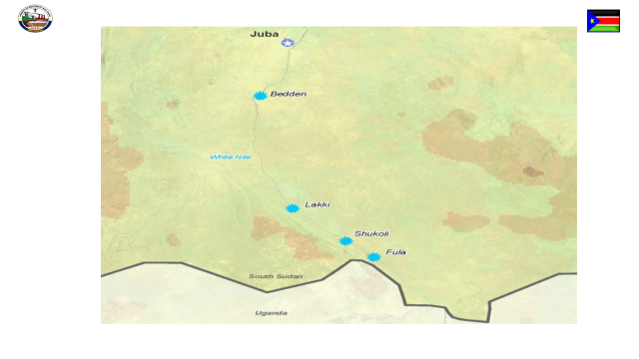
HYDRO PLOTENTIAL LOCATIONS
Bedden
Lakki
Shukoli
Grand Fula

Slide 11
ENERGY POTENTIAL RESOURCES
ii. SOLAR
The RSS experiences approximately 12 hours/day
of sunshine all round the year and radiation is 4.0 to
6.0 kwh/m²/day.
iii. WIND
Wind power density in South Sudan is at the high lands
bordering Kenya and Uganda ranging from 285 – 380 W/m²;
wind velocity is 12.5m/s.

Slide 12
ENERGY POTENTIAL RESOURCES
iv. BIOMASS
Is estimated at 71.1 million hectares, and is the
source of energy to majority of the population.
v. GEOTHERMAL
The country geographical conditions are favorable
to geothermal resources; However, they have not
been explored.

Slide 13
ENERGY POTENTIAL RESOURCES vi. Fossil Fuel Thermal Power Potential
S/N | PROJECT NAME | Location | CAPACITY (MW) | STATUS
1. | Tharjath Power Plant | Unity State | 300-500 | Need Funding and Development
2. | Polouge Power Plant | Upper Nile State | 500-750

Slide 14
IMMEDIATE PRIORITY PROJECTS
SHORT – MEDIUM TERMS

Slide 15
1. OFF-GRID PV SOLAR POWER PROJECTS
S/N | LOCATION | CAPACITY (MW) | STATUS
1. | Malakal | 50 | REQUIRE FUNDING FOR FEASIBILITY STUDIES AND DEVELOPMENT
2. | Torit | 20
3. | Awiel | 20
4. | Wau | 20
5. | Rumbek | 10
6. | Yambio | 10
7. | Bor | 20
8. | Pibor | 10
9. | Rweng | 10
9. | Bentiu | 10
10. | Kuajok | 20
Notes:
TO FASTRACT THE ELECTRIFICATION OF THE CAPITAL STATES

Slide 16
2. REGIONAL INTERCONNECTION TRANSMISSION LINES
S/N | Project Name | Voltage (kV) | Distance (Km) | Project Status
1. | Uganda (Olwiyo)-South Sudan (Nimule-Juba). | 400 | 382 | Feasibility Study is now going on funded by the Afdb. Need funding for construction
2. | Ethiopia (Gambella)- South Sudan ( Malakal) (Phase 1) | 230 | 357
3. | Renk - Malakal | 220 | 353 | Funding is needed to implement the Contract

Slide 17
3. INTER-STATE TRANSMISSION LINES PROJECT (NATIONAL GRID)
S/N | Overhead Transmission Line | Voltage Level (kV) | Est. Distance (km) | Configuration
1. | Juba – Bor – Ayot – Malakal | 400 | 517 | Single Circuit
2. | Juba -Ramciel- Rumbek –Wau- Tharjath- Bentiu | 400 | 934 | Single Circuit
3. | Wau-Kuajok- Awil- Raja-Abyei | 220 | 233 | Single Circuit
4. | Juba -Mundri-Maridi-Yambio-Tombura | 220 | 690 | Single Circuit
5. | Juba -Torit-Kapoeta | 220 | 359 | Single Circuit
6. | Juba-Yei- Kaya-Kojikeji | 132 | 280 | Single Circuit

Slide 18
FUTURE PRIORITY PROJECTS
LONG TERM

Slide 19
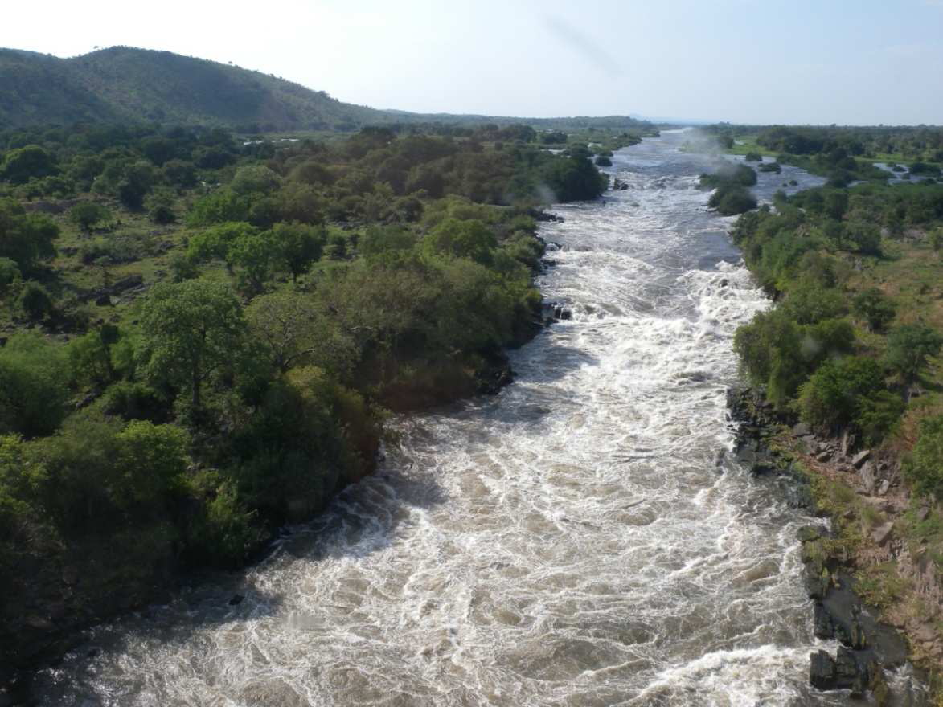
THE PRIORITY HYDRO POWER PROJECT 1. GRAND FULA HYDROPOWER
White Nile River, 34km down stream of
Nimule, and 137km upstream from Juba

Slide 20
Basic Information of Grand Fula Hydropower Project
S/N | Details | Comments
1 | Project Name | Grand Fula Hydropower Project
2 | Location | White Nile River, 34Km down Stream of Nimule, and 137 Km upstream from Juba.
3 | Capacity | 1080 MW
4 | Cost of Investment | US$1.5 Billion
5 | Cost of Average Energy | 6$cent per Kwh
6 | Project Mode | Finance, Build, Operate and Transfer (BOT)
7 | Implementation Period | 75 Months

Slide 21
THE OBJECTIVES OF GRAND FULA HYDROPOWER PROJECT
(i) To supply Cheap, Reliable, Affordable and Sustainable
electricity power to meet Residential, Commercial,
Agricultural and Industrial demand for socio-economic
development to the people of South Sudan;
(ii) To supply extra electricity power to East African
Power Pool(EAPP) for widening the Country’
electricity power trade in the region.

Slide 22
THE PROCEEDES OF GRAND FULA HYDRO POWER PROJECT AND THE WAY FORWARDS
(i) The Feasibility Studies completed in 2009, but still the Government of South Sudan needs to meet the payment of US$12 million to own and update the documents; (ii) The Government of the Republic of South Sudan avails the opportunity and invites the potential investor/s to develop the Grand Fula Hydropower as it’s Top Energy Priority Project to electrify the countrywide.

Slide 23
2. INTERCONNECTION TRANSMISSION LINES
S/N | Overhead Transmission Line | Voltage Level (kV) | Est. Distance (km) | Project Status
1. | Ethiopia (Dedesa-Tepi)-South Sudan (Bor- Juba) (Phase 2) | 400 | 700 | Need Funding for Feasibility Study and Construction
2. | Kenya (Lokichogio)- South Sudan (Kapeota-Torit-Juba) | 220 | 480

Slide 24
CHALLENGES
The energy projects are capital intensive need access to capital;
2. Regulations and conditions imposed by lenders before
approving a loan.(Government to provide 15 to 20%
down payment;
3. In-adequate infrastructures.

Slide 25
RECOMMENDATIONS
The Government of South Sudan has to prioritize energy as a critical input to the country’s recovery program, stability and development.
2. Grand Fula Hydropower Project is strongly recommended
as the Top Energy Priority Project for the socio-economic
development of the people of South Sudan.
The Government has to acknowledge the need to develop the
Intuitional capacity and Capacity building of the energy sector.

Slide 26
CONCLUSIONS
South Sudan has abundant energy resources waiting to be harnessed for development to uplift the standard living of its people.
There is massive investment opportunities in the energy sector, which require resources for infrastructure development from the Government, Investors and Donors.
The expectations of the economy and the people of South Sudan are great and will require also the prioritization of the energy sector as the driving wheel of the development.

Slide 27
THANKS FOR YOUR ATTENTION

